Slide 1
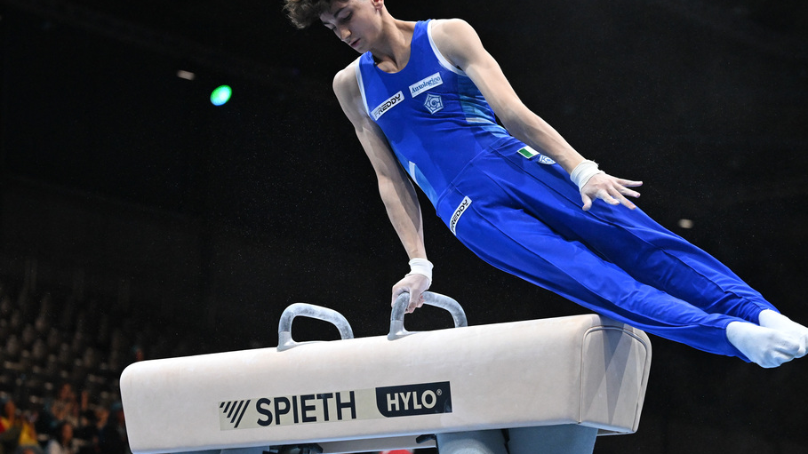
Visual analytics for gymnastics performance
Male Artistic Gymnastics
Olympic Cycle 2022-2024

Slide 2
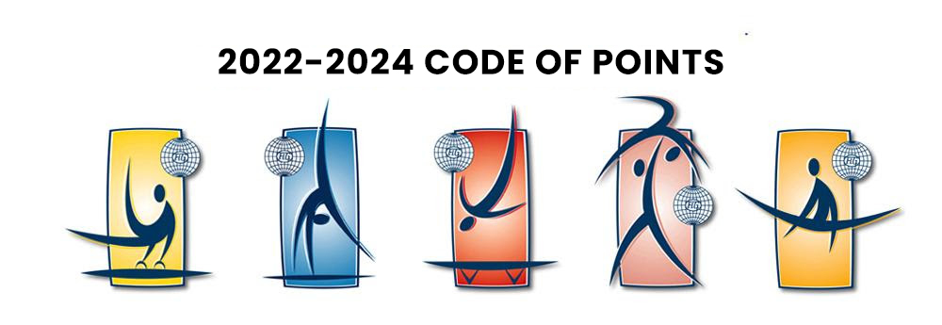
Topic
Men Artistic Gymnastics Performance 2022-2024
Gymnastics is a sport based on performance evaluation set on values such as D-score, E-score and penalties.
Results on apparatuses and competitions produce large volumes of data but rarely analyzed.
Here we try doing that taking data from official international competitions.

Slide 3

Data Retrieval
Data was collected from the official results page of International Gymnastics Federation, World Gymnastics, from competitions .pdf files then exported in .csv ones.
Data retrieval was done taking into account European and World Championships from 2022 to 2024, so having the same Code of Point for all competitions making the analysis duable.

Slide 4
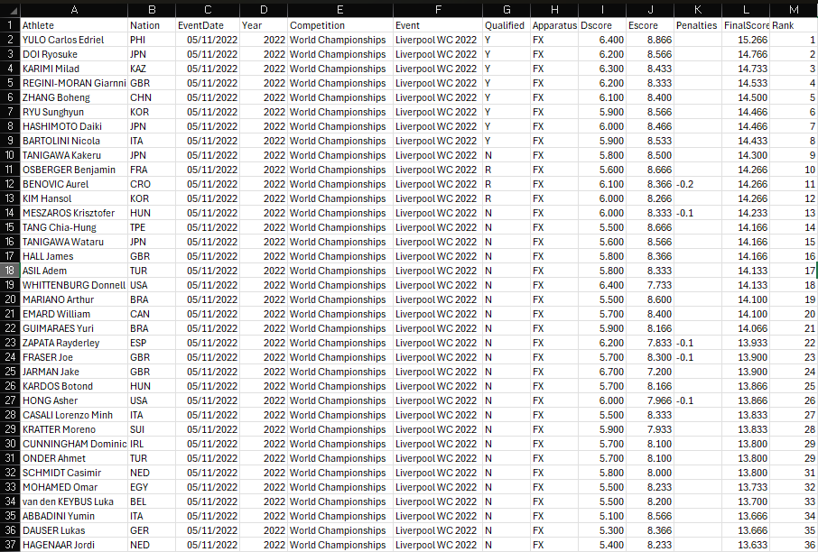
Data sources
.csv files have been selected and grouped at first by year then all tuples collected in a single file having 13 attributes useful for analysis:
Athlete
Nation
EventDate
Year
Competition
Event
Qualified
Apparatus
Dscore
Escore
Penalties
FinalScore
Rank

Slide 5
Data sources
The entire data source used for the analysis has the following dimensions for each year:
1464 for 2022 with 2 competitions (1 WCH, 1 EUCH)
1456 for 2023 with 2 competitions (1 WCH, 1 EUCH)
702 for 2024 with 1 competition (1 EUCH)
The total of the three years is so 3622 with 13 attributes making the value:
AS = #tuples x #dimensions = 47.086

Slide 6

Intended Users
Coaches and technical staff for performance assessment and comparison
Analysts and researchers interested in competition-level trends
Athletes seeking insight into strengths, weaknesses, and consistency
Federation staff for high-level performance monitoring

Slide 7
Data preprocessing
Removal of incomplete records and entries with missing or non-informative attributes
Selection of relevant performance variables (D-score, E-score, Final Score, penalties)
Standardization and cleaning of categorical fields (athlete, apparatus, competition, year)
Preparation of data subsets for interactive filtering and dimensionality reduction

Slide 8
Data visualization
The complete dashboard is composed of 4 main interactive charts and filters to make the analysis easier to control and interact with.
Scatter Plot (D vs E): provides an overview of the relationship between Difficulty and Execution scores, highlighting qualification outcomes and athlete distributions.
Performance Trend View: shows how Final Scores vary across competitions and years, supporting the analysis of trends and variability.
Heatmap: summarizes average Final Scores across apparatuses and temporal dimensions, enabling quick comparison of performance patterns.
PCA Projection: reduces multidimensional performance data into a two-dimensional space to explore similarities between athlete.

Slide 9
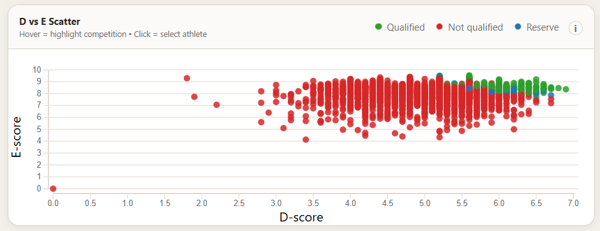
D vs E scatter plot
Relation between Difficulty and Execution score
Each point represents an athlete’s performance in a specific event
Color encodes qualification status (qualified, reserve and not qualified)

Slide 10
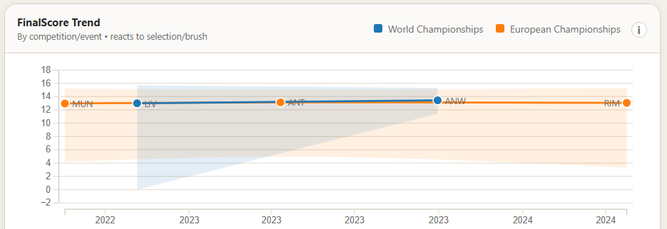
Performance Trend
Visualizes final score evolution across multiple years and competitions
Dot-interval representation:
  Dot: mean final score
  Interval: minimum-maximum range

Slide 11
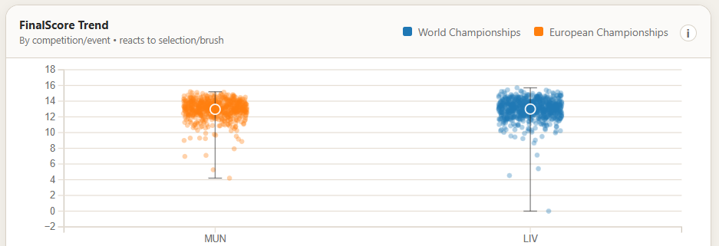
Performance Trend
Focused on a single year for event comparison
Highlights differences in performance variability across events
Displays event-level final score using a dot-interval representation

Slide 12
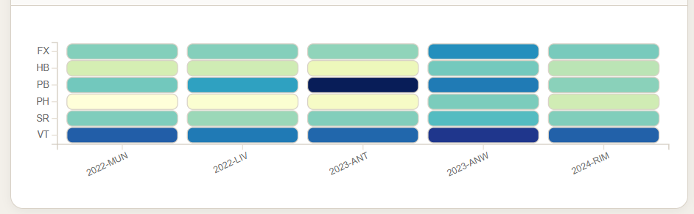
Apparatus x Year/Event Heatmap
Displays average final scores using color intensity
Rows represent apparatuses, columns represent temporal categories
Quick comparison of performance patterns across apparatuses

Slide 13
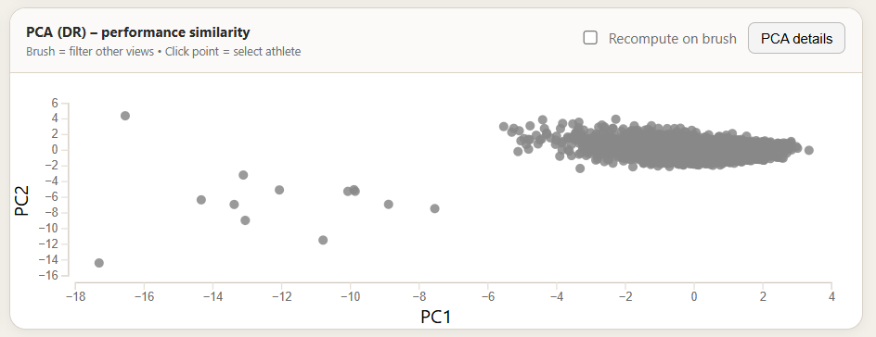
Principal Component Analysis (PCA)
Project multidimensional performance metrics into a 2D space
Spatial proximity indicates similar performances
Input features include Difficulty, Execution, penalties, and Final Score

Slide 14
Application cases
Comparison of athlete performances across competitions and years
Analysis of apparatus-specific performance patterns
Identification of consistency and variability in Final Scores
Exploration of athlete similarity through PCA-based projections

Slide 15
Possible improvements
Extension to additional competitions and Olympic cycles
Integration of routine-level or biomechanical performance data
User-centered evaluation with coaches and domain experts
Inclusion of advanced analytical or predictive techniques

Slide 16
End.

